Slide 1
MOPAC VAWG Grassroots Fund
Anneka Singh
Programme Manager
Temi Pratt
Information Session
Programme Co-ordinator
24th November 2020

Slide 2
Agenda
Introductions
VAWG Grassroots Fund
Interactive activity: Icebreaker (15 minutes)
Funding Available and Fund Split
TSIP: Fund Co-design
Who Can Apply?
What Will We Fund?
What Won't We Fund?
Key Dates
How To Apply
What Makes A Good Application?
Applicant Support
Interactive activity: Q&A Session

Slide 3
Who we are
We are The London Community Foundation, the charity for London’s grassroots.
We specialise in supporting community-based organisations focused on helping disadvantaged London.
We believe in a strong and vibrant London.
We support those best placed to make an impact locally.
We identify change makers in the community, and champion grassroots initiatives, taking a community development approach to
grant-making.

Slide 4
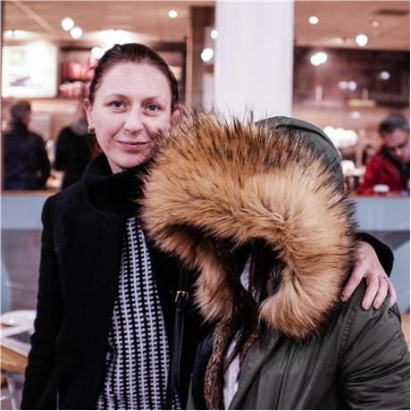
What we do
Physical and mental health & wellbeing
Life skills, education, employability & enterprise
Strengthening community cohesion
Reducing isolation and disadvantage, and increasing access to local services
Connecting people with the arts, culture & heritage
We work with a wide range of individuals, companies and partners to effect change in the community. Through our grant making to grassroots organisations and initiatives, we support those looking to improve their life chances.
In the last year, we awarded over £8 million to projects across the capital, giving out over 1,000 grants annually.
Our work largely focuses on five key themes:

Slide 5
The Social Innovation Partnership (TSIP)
We are a diverse team of technical and community specialists joining forces to drive social change. We support our partners to better understand the issues they care about and increase their positive impact on people and communities.
We lead with empathy and curiosity in order to really get to know our partners and build trusting relationships. Our approach is collaborative, participatory and enabling. We work across sectors and on the ground with groups that share our values.
Fancy Sinantha, Strategic Advisor/Project Director
Our role on this Fund is to support co-design of prospectus, capacity building, and oversee Fund Theory of Change and monitoring & evaluation.
Tyler Fox,
Project Manager

Slide 6
MOPAC VAWG Grassroots Fund
The London Community Foundation is pleased to launch the Mayor’s Violence Against Women and Girls (VAWG) Grassroots Fund. This Fund is managed in partnership with The Social Innovation Partnership (TSIP).
The Covid-19 pandemic has had a damaging impact on community organisations and has changed the way we work for the foreseeable future. We are now operating in a context where violence against women and girls (VAWG) is occurring alongside a global health crisis and are aware that this has further facilitated opportunities for violence and abuse.

Slide 7
Interactive activity: Icebreaker

Slide 8
Funding available
Two-year grants of up to £100,000 (£50,000 per year) for individual organisations.
Partnerships of up to three organisations can apply for two-year grants of up to £120,000 (£60,000 per year). In order to qualify as a partnership, applicants must have a partnership agreement (written document) or equivalent in place before applying.
We expect between 40-50 grants to be awarded from the £3m available funds.

Slide 9
Funding split
A minimum of 60% of the funds will go to by and for BME women's organisations delivering VAWG services.
A maximum of 40% will go to grassroots organisations providing VAWG services for other minoritised groups such as disabled women, LBTQ+ women, women with No Recourse to Public Funds and women involved in prostitution.
Examples are available in the Fund Prospectus.

Slide 10
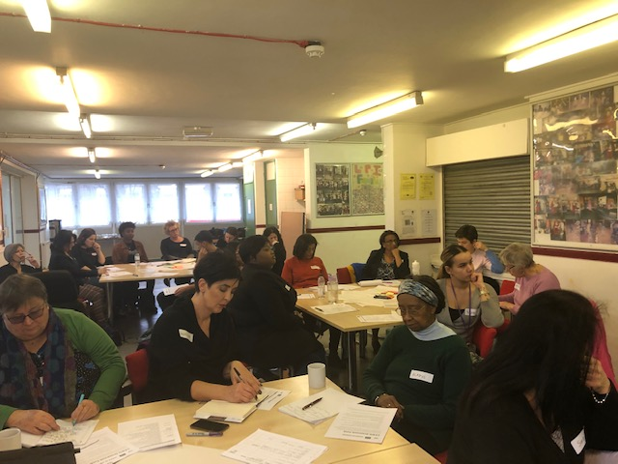
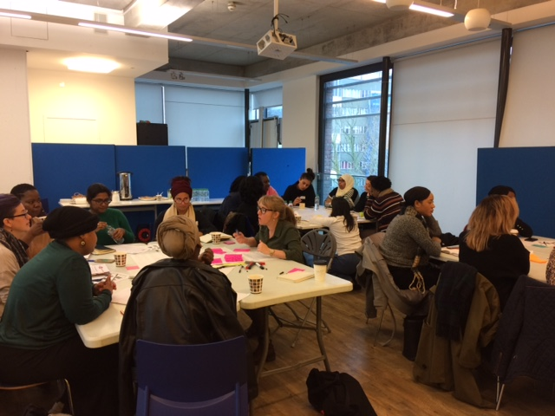
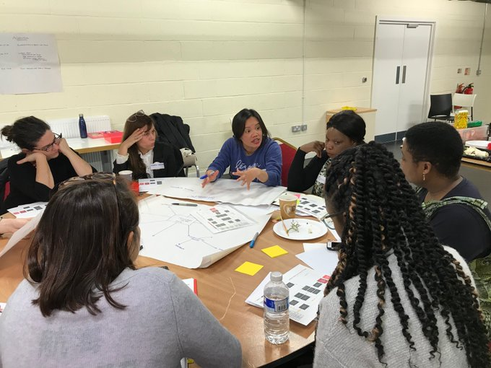
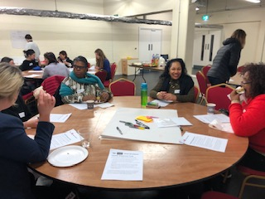
TSIP – Co-design and capacity building
How your experiences have shaped the design of this fund so far… The community we brought together
VAWG grassroots community organisations represented
70
Service specialisms represented
General support for gender-based violence
CSE & gang exploitation
Domestic and sexual violence
VAWG prevention
Migrants and refugees
Support groups
Supporting non-abusing parents and carers
Cultural and language-specific services
Boroughs represented
23/32 London boroughs represented:
Lambeth, Greenwich, Croydon, RBKC, Ealing, H&F Lewisham, Southwark, Islington, Tower Hamlets, Enfield, Newham, Tottenham, Waltham Forest, Hackney, Kingston, Barnet, Merton, Redbridge, Camden,Barking and Dagenham, Brent, Hillingdon, Merton

Slide 11
TSIP – Co-design and capacity building
What we have heard from you so far..
Peer learning, training, & support
Capacity building sessions that require staff attendance should either be held locally or online, and should be remunerated
Capacity building activities should be totally relevant and led by the needs of grantees
Grantees should have access to an online resource hub, as well as bespoke tools and software
Grantees should be able to access various kinds of support related to long-term funding strategy and business planning
Capacity building events should emphasise, encourage and facilitate partnership working across the sector
Events should provide grantees with the opportunity to network with other funders, larger VAWG orgs, universities and policymakers
Organisations would benefit from a coach who is also a role model
Smaller organisations require a range of back office support, eg upskilling staff on bid writing
Organisations need support recruiting diverse and well-connected trustees
Capacity building requirements should be streamlined for organisations that hold multiple MOPAC grants

Slide 12
TSIP – Co-design and capacity building
How your experiences will shape the future of this Fund…..
Peer learning, training, & support
Successful grantees will participate in co-designing events later this year to develop a VAWG grassroots led programme of capacity building activities that meet the needs of your organisations.
We will try to decide together what activities (training and support) are mandatory and what are flexible and will endeavor to ensure they are all accessible and inclusive.

Slide 13
Who can apply?
Only one application per organisation will be accepted, including as part of a partnership bid.
Applicants must:
Currently be providing services to address VAWG
Be able to demonstrate a minimum of three complete years of operation
Be delivering the work they are requesting funding for in London, with a preference for organisations based in London

Slide 14
Who can apply?
We will accept applications from organisations with the following legal status:
Constituted voluntary and community groups that have a minimum of 3 unrelated members responsible for the governance of the organisation; trustees / directors / management committee, as appropriate
Registered charities
Community Interest Companies (CIC) Limited by Guarantee
Charitable Companies (Limited by Guarantee)
Charitable Incorporated Organisations (CIO)

Slide 15
What is eligible for funding?
Applicants can apply for the following costs in relation to the continuation or expansion of existing VAWG services, or a new element of their work in tackling VAWG:
staffing,
volunteers,
equipment/small capital items,
office/overhead/premises costs/training (i.e. core costs)
publicity costs,
adaptations required due to Covid-19 (i.e. risk assessments/ new equipment or technology) and/or
training required due to Covid-19 (i.e. online safeguarding/ digital training)

Slide 16
What won’t we fund?
We are unable to consider applications from, or that support, the following:
Local Authorities, or any activity that is a statutory requirement
Any party-political activities
Purely commercial ventures (for profit)
Spending that has already taken place (i.e. retrospective funding)
Community Interest Companies Limited by Shares
Individual sponsorship / individuals or projects run by individuals as opposed to an organisation
Activities promoting religious belief

Slide 17
What won’t we fund?
We are unable to consider applications from, or that support, the following:
Statutory agencies in the criminal justice system, including the Metropolitan Police Service
Organisations whose current liabilities have exceeded their current assets at the last two balance sheet dates
Organisations where trustees are paid, unless evidence of approval is provided from the Charity Commission and/or this arrangement is referenced in the governing document
Organisations with fewer than 3 unrelated members responsible for the governance of the organisation; trustees / directors / management committee, as appropriate

Slide 18
Key Dates
Opens for 8 weeks from Monday 16th November 2020.
The deadline for full applications is 12pm on Monday 11th January 2021.
LCF is holding a range of online and telephone Applicant Support whilst the Fund is open.

Slide 19
How to apply
There is a two-stage process for applications to the VAWG Grassroots Fund.
Eligibility Checking: All applicants must answer a few short questions about their organisation and proposal to ensure they are eligible before being invited to complete a full application form. We aim to respond within 48 hours.
Full Application: This will be sent to organisations that are eligible to apply.

Slide 20
How to apply
If eligible for the Fund: You will receive a link to register for access to an online application form. Please click this link and then read the instructions carefully.
If ineligible for the Fund: LCF manages a range of other funds dedicated to supporting grassroots organisations that your organisation might be eligible for. Please sign up for the newsletter and it will signpost you to other appropriate funding sources.

Slide 21
What makes a good application?
The level of detail will depend on the size of the
funding available.
Basics
Fits the funding criteria
Is complete
Up-to-date submissions to Charity Commission/ Companies House
Correct legal status
Good previous monitoring (if applicable)

Slide 22
Continued….
When looking at an application we will look at:
All supporting documents, do they demonstrate good governance and operation?
Do we know what the organisation does?
Do they have a track record?
Is the project well planned?
Does the project respond to an identified need?
Who is the target beneficiary?
Has the group considered how they will engage beneficiaries?
Has the applicant considered what the anticipated benefits will be and how they will measure this?
Detailed, well planned budget that relates to the project described – apply for what you need and ensure value for money.
This is not an exhaustive list!

Slide 23
What makes an application stand out?
Ability to achieve demonstrated by previous results achieved/skills in place
Effective partnership working
Project responds to previous learning
Strong needs analysis/consultation
If applicable, excellent previous monitoring showing good results
Good monitoring/evaluation plan –important to show your results
Sustainability and fit with wider organisational objectives
Clear and concise

Slide 24
The Elevator Pitch
What would you like to do with your grant? Please describe your project or activity.
Your answer should begin with one or two sentences summarising your project.
It should be concise
It should answer:
What you intend to do
How long you intend to do it for
Where you intend to do it
For whom it will be for
Is reflective of what your budget outlines

Slide 25
Demonstrating Need
What are the problems or issues that this project will address and how do you know?
What are the issues and how do you know your project is needed/wanted? You can demonstrate need through:
Personal experience
Surveys you have carried out
Current demand on your services
Statistics:
There has been an increase in the need for VAWG services due to the Covid-19 and subsequent lockdown (Women’s Resource Centre, 2020).
Calls to the National Domestic Abuse Helpline (NDAH) increased by 25%.
Amidst the COVID-19 first wave outbreak, 22% of VAWG services surveyed reported they were unable to effectively support adults victims of abuse and 42% were unable to effectively support child victims of abuse (SafeLives, 2020).
Data for London can accessed through the free: London Data Store

Slide 26
Impact: outcomes vs outputs
Outputs:
10 people trained to be able to support Women experiencing domestic abuse
20 women supported via telephone one to one services
Emergency accommodation found for 5 women
Outcomes:
More support provided to women experiencing domestic abuse
Women more confident to access the helpline
Women provided with a safe living environment; escaping domestic abuse situations
Note on impact section: the numbers you enter will be the numbers you will be asked to report against in the monitoring form – better to underestimate rather than overestimate!

Slide 27
Assessment
During assessments, we will be looking at:
Your track record
Need/demand for your service
Project plan
Budget
Impact
Sustainability
Your assessor may call you during assessment if they have any questions about your application.

Slide 28
If you don’t get funded…
We get more “fundable” applications than we can actually fund
Many considerations are taken into account
It is not necessarily a judgement on your organisation, the quality of your application or the need for your services
Keep trying
Always phone if you are not sure

Slide 29
Top tips
Always ask someone to read through your application before submitting
Access resources through the VAWG Grassroots Fund page, for additional application support
Keep your responses in a Word document and copy and paste them into the form
Avoid claims such as “We are the only...”
Use the Full Cost Recovery Model for your budget
Refer to the Online Application Form Guidelines when filling out the form
If you are not sure, phone!
Sum up your project in one sentence

Slide 30
Any questions?
Q & A
One to One Sessions (book here)

Slide 31
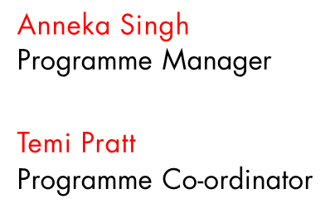
Thank you!
VAWGGrassrootsFund@londoncf.org.uk

